Slide 1
Introducing SMT/Z3
Nikolaj Bjørner, Microsoft Research, RiSE
TU Wien 2025
A Laura Kovacs guest lecture production

Slide 2

Why SMT?
Claim: Every program analysis, test and verification scenario involves at a core solving symbolic formulas
SMT supports formalisms suitable for program analysis
SMT solver technologies tune for SAT and UNSAT equally.
Laura Kovacs and Greta Yorsh

Slide 3
Material
z3 source on GitHub https://github.com/z3prover/z3
Online guide https://microsoft.github.io/z3guide
Tutorial document https://z3prover.github.io/papers/z3internals.html

Slide 4

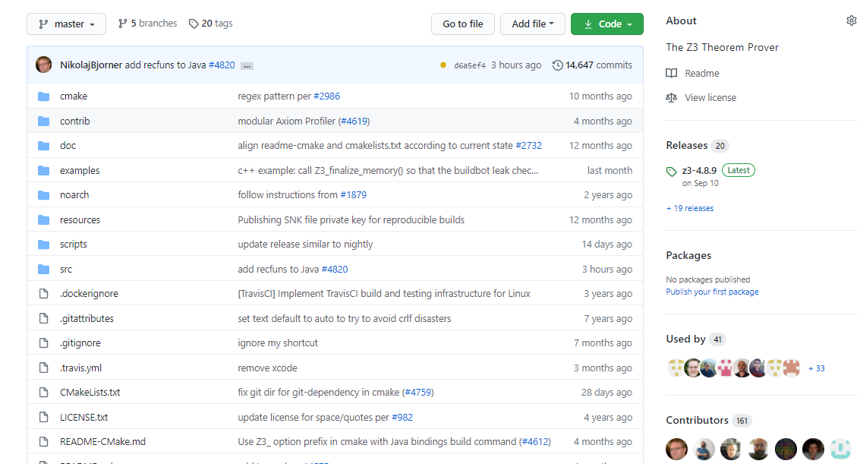
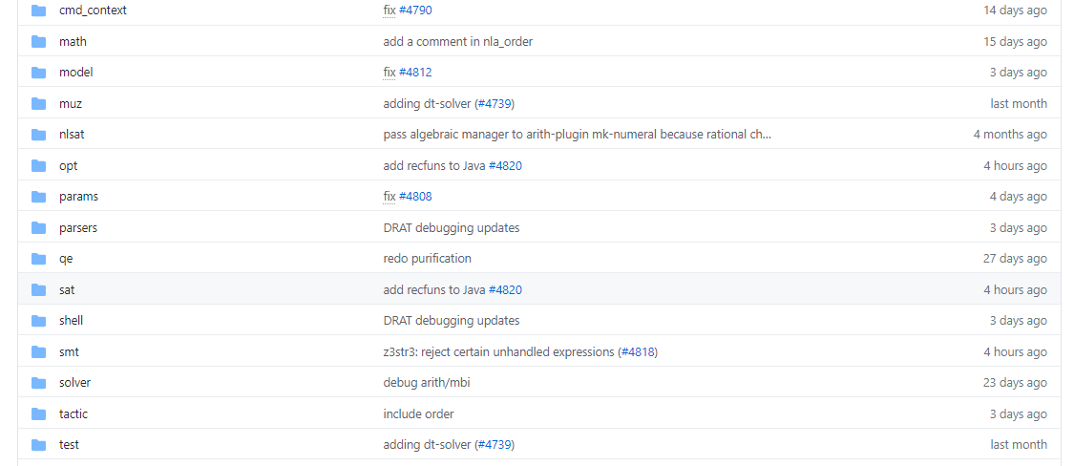
on GitHub
Scope of this tutorial

Slide 5
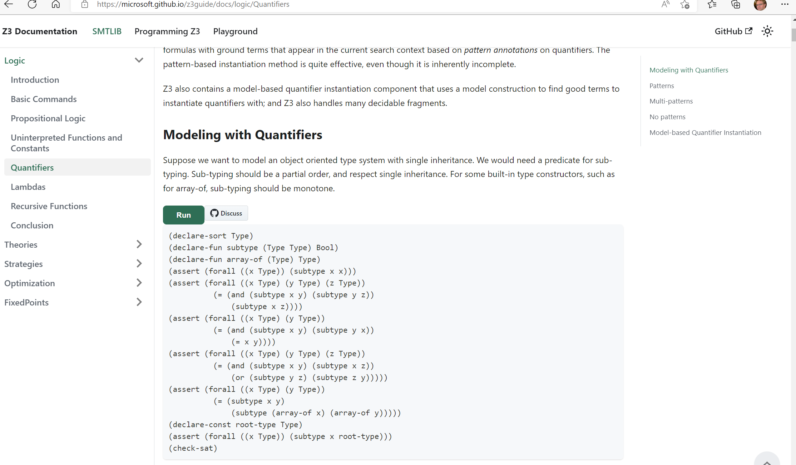
Online guide

Slide 6
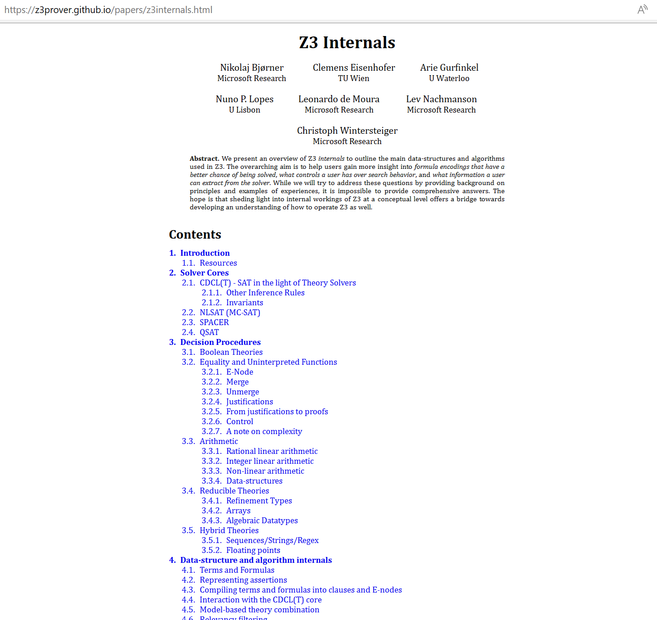
Tutorial document

Slide 7


Background Reading: SMT
September 2011

Slide 8
SAT in a nutshell

Slide 9
SAT in a nutshell
(Tie ∨ Shirt) ∧ ( ¬Tie ∨ ¬Shirt) ∧ (¬Tie ∨ Shirt)

Slide 10
SMT in a nutshell

Slide 11
Satisfiability Modulo Theories (SMT)
Is formula ϕ satisfiable modulo theory T ?
SMT solvers have specialized algorithms for T

Slide 12
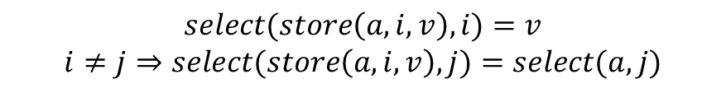
Satisfiability Modulo Theories (SMT)
$$x+2=y⇒f\left(select\left(store\left(a,x,3\right),y−2\right)\right)=f(y−x+1)$$
Array Theory
Arithmetic
Uninterpreted Functions
$$select(store\left(a,i,v\right),i)=v$$
$$i≠j⇒select(store\left(a,i,v\right),j)=select(a,j)$$

Slide 13
SMT Solving in a nutshell
Job Shop Scheduling

Slide 14






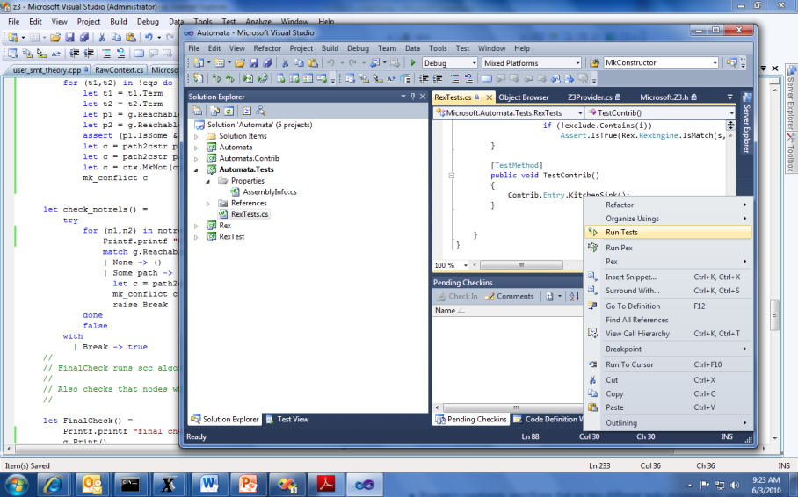


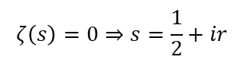
Job Shop Scheduling
Machines
Tasks
Jobs
P = NP?
Laundry
$$ζ\left(s\right)=0⇒s=\frac{1}{2}+ir$$

Slide 15

Job Shop Scheduling
Constraints:
Precedence: between two tasks of the same job
Resource: Machines execute at most one job at a time
3
1
2
4
$$\left[start_{2,2}..end_{2,2}\right]∩\left[start_{4,2}..end_{4,2}\right]=∅$$

Slide 16
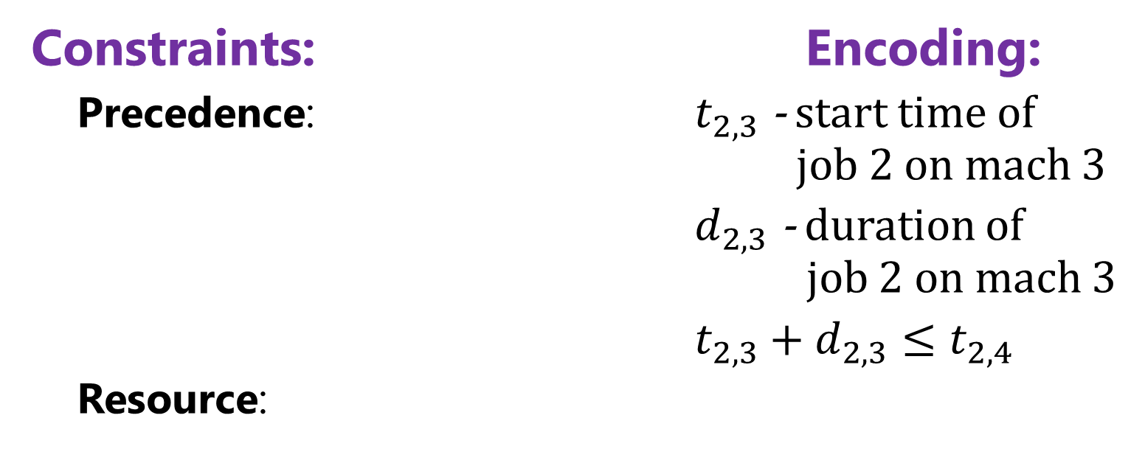
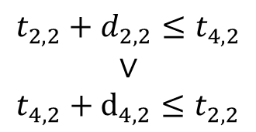
Job Shop Scheduling
Constraints: Encoding:
Precedence: $t_{2,3}$ - start time of job 2 on mach 3
$d_{2,3}$ - duration of job 2 on mach 3
$t_{2,3}+d_{2,3}≤t_{2,4}$
Resource:
3
1
4
2
Not convex
$$t_{2,2}+d_{2,2}≤t_{4,2}$$
$$∨$$
$$t_{4,2}+d_{4,2}≤t_{2,2}$$
$$\left[start_{2,2}..end_{2,2}\right]∩\left[start_{4,2}..end_{4,2}\right]=∅$$

Slide 17
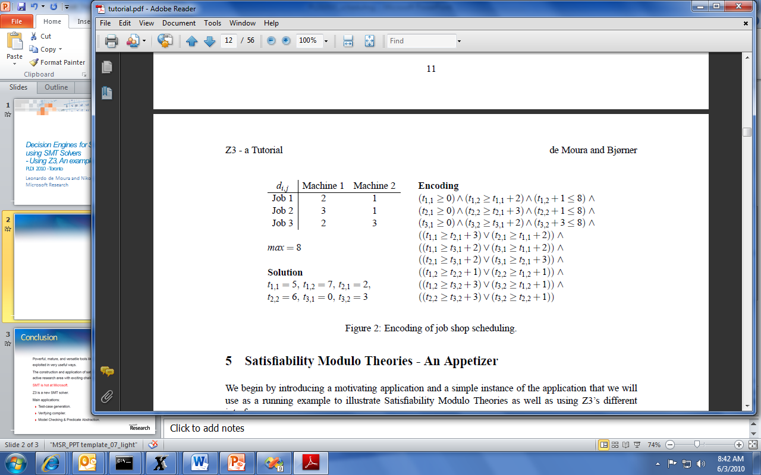
Job Shop Scheduling

Slide 18
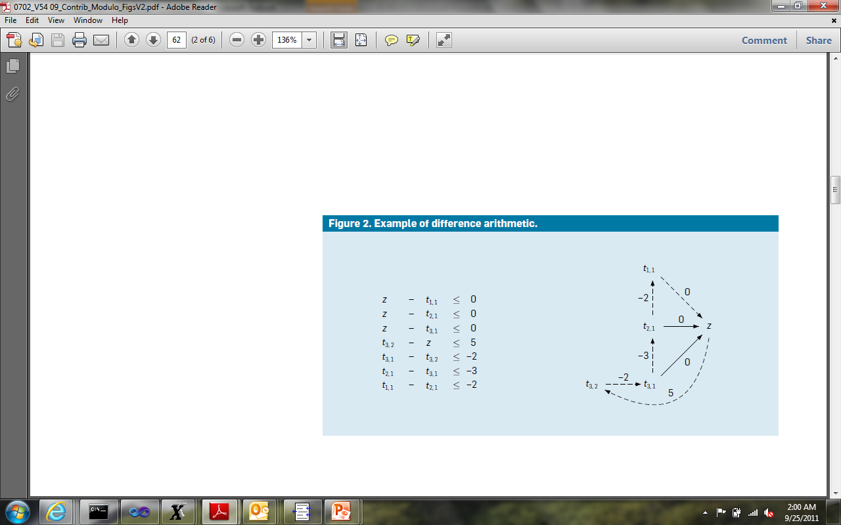
Job Shop Scheduling
Efficient solvers:
- Floyd-Warshal algorithm
- Ford-Fulkerson algorithm
case split
case split
$$z −z= 5 – 2 – 3 – 2 = −2 < 0$$

Slide 19
What to expect when expecting a z3 internals lecture?

Slide 20



What (some) users want to learn
How can I tune formulas to be solved by Z3?
What features of Z3 should I use for solving formulas?
Can I control the output of Z3
models (to be diverse, random)?
How can I have Z3 provide feedback on solving?
How can I determine which strategies apply to my formulas?

Slide 21
What a developer likes to talk about
Solvers
Algorithms
Data-structures
Logic features
Proof systems
Heuristics
Anatomy of Congruence Closure
How do solvers interact (with the core)?
How do solvers implement search?

Slide 22
Lectures setup
Exploring Z3 Concepts with use cases
Understand Solver Internals

Slide 23
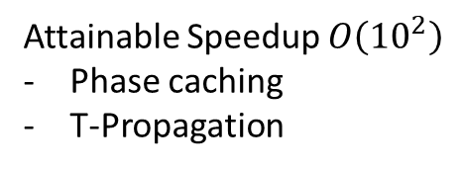
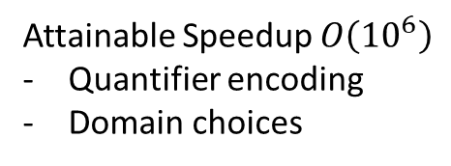
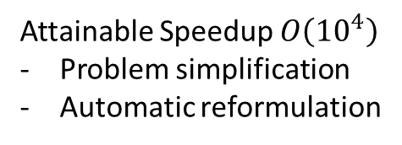
Encodings, Pre-processing, Search
Encoding
Attainable Speedup $O\left({10}^{6}\right)$
Quantifier encoding
Domain choices
New
Theory solver
Pre-processing (Tactics)
Attainable Speedup $O\left({10}^{4}\right)$
Problem simplification
Automatic reformulation
Advances in Search
Attainable Speedup $O\left({10}^{2}\right)$
Phase caching
T-Propagation
Thanks to D.O.F. Pons

Slide 24
Hands on Lecture Theme
We are going to develop a theory solver for finite sets from scratch
Participation: Add PRs into Z3

Slide 25
Finite Sets Decision Procedure
Does not exist in Z3 yet
An occasional ask
Illustrates many concepts and areas of z3
Win-win: you learn and add a valuable component to z3

Slide 26
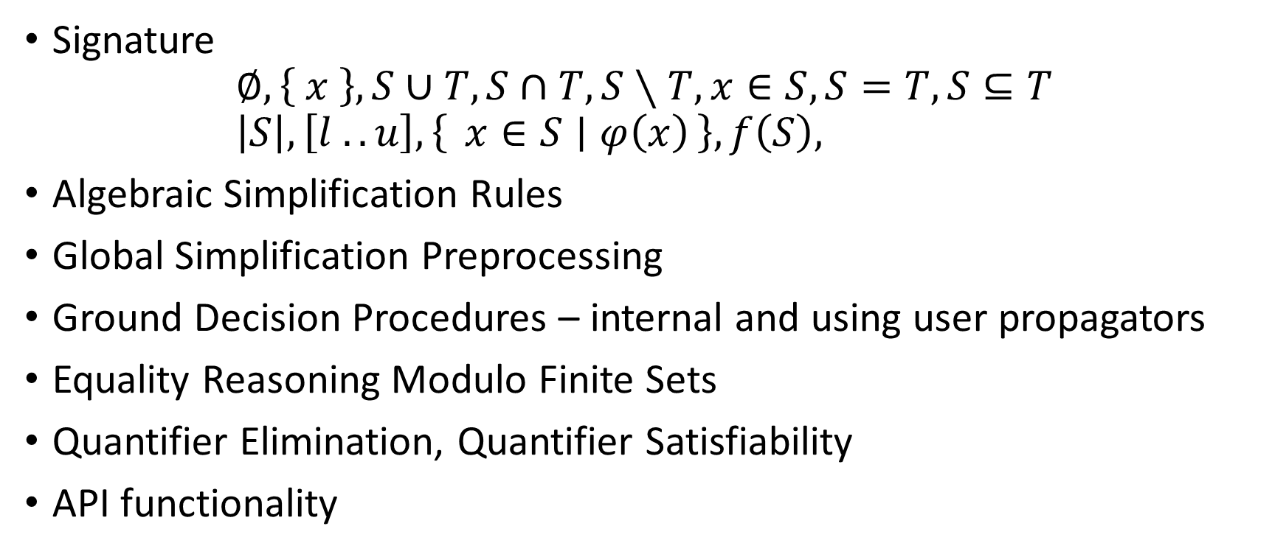
Finite Sets Decision Procedure - Elements
Signature $∅, \left\{ x \right\}, S∪T, S∩T, S∖T, x∈S, S=T, S⊆T$ $\left|S\right|, \left[l .. u\right], \left\{ x∈S ∣ φ\left(x\right)\right\}, f\left(S\right),$
Algebraic Simplification Rules
Global Simplification Preprocessing
Ground Decision Procedures – internal and using user propagators
Equality Reasoning Modulo Finite Sets
Quantifier Elimination, Quantifier Satisfiability
API functionality

Slide 27
An entry-point to other theory solvers
Separation Logics
Co-algebras
Relational algebras
Partial Orders
Global Propagators for constraint domains

Slide 28
Big-picture Interfacing with Z3

Slide 29
Efficiency
Scale
Technology Landscape
Propositional
Satisfiability Solving
SAT
Breakthroughs in 2000s
Cheap local Inferences
Garbage collect useless clauses
Hardware Design
Automation
Breakthroughs late 2000s
SAT + global inferences +
global propagators
Mixed Integer
Programming
MIP
Breakthroughs in 1960s
Harnessed since 1990s
LP: global Inferences
IP: Cuts, Branch and Bound
Satisfiability Modulo Theories
Operations
Research
CP-SAT
SMT
Z3
Constraint
Programming
Software Development +…
CP
Breakthroughs since 1990s
Powerful domain-tailored
global propagators
Expressive Power

Slide 30


But, what about
Program Verification
using SMT
Proof assistants
using SMT
LEAN?
Stanford Pascal Verifier
NQTHM, ACL2
AutoActive?
ESC/Simplify, STeP
EHDM, PVS
Boogie
Isabelle, Coq Hammers
Imandra, ….

Slide 31

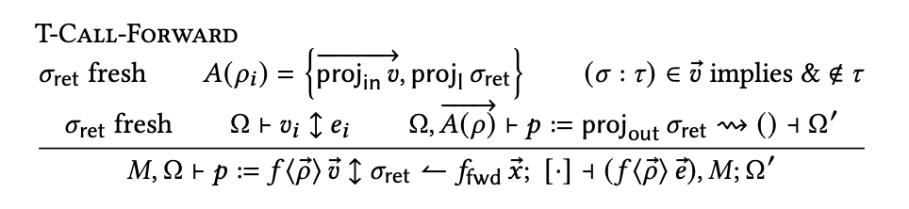
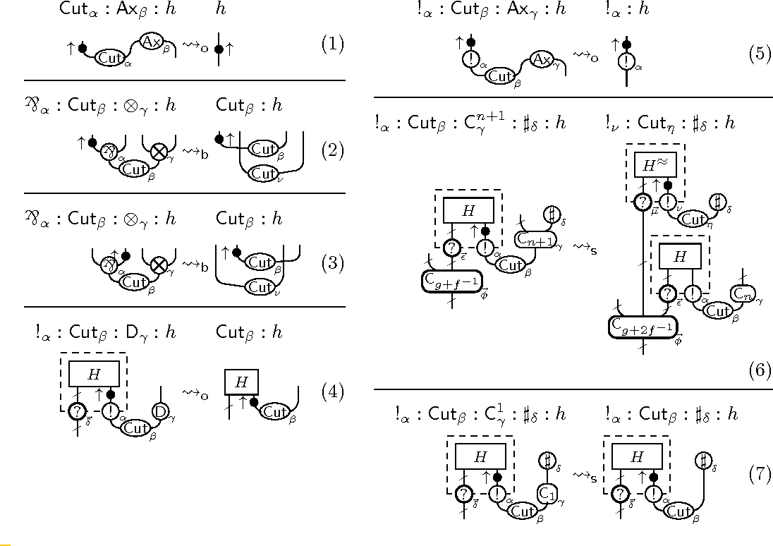
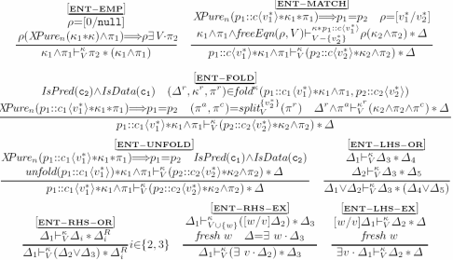
Systems Code Verification: Type theory vs Floyd-Hoare-Dijkstra
FP & Logics
Boogie (2004)
F# (2001)
KISS (2004)
Spec# (2004)
Verve (2010)
F7 (2007)
HAVOC (2010)
VCC (2009)
Vale (2017)
F* (2012)
Dafny (2010)
Chalice (2010)
EverCrypt (2019)
EverParse (2019)
Verona (2022)
Ironfleet (2015)
CIVL (2015)
Viper (2016)
SLAyer (2008)
Steel (2020)
VeriSol (2018)
Armada (2020)
Verus (2022)
Separation Logic (1999)

Slide 32
Verified systems at SOSP, OSDI
Python
IsabelleHOL
seL4 (SOSP 2009)
assembly
Ironclad (OSDI 2014)
Jitk (OSDI 2014)
Dafny
IronFleet (SOSP 2015)
FSCQ (SOSP 2015)
C
Yggdrasil (OSDI 2016)
LLVM
CertiKOS (OSDI 2016)
Komodo (SOSP 2017)
C
DFSCQ (SOSP 2017)
Hyperkernel (SOSP 2017)
CSPEC (OSDI 2018)
Coq
Z3
Nickel (OSDI 2018)
DiskSec (OSDI 2018)
Serval (SOSP 2019)
Rosette
Perennial (SOSP 2019)
Vigor (SOSP 2019)
Go
VeriFast
AtomFS (SOSP 2019)
Jitterbug (OSDI 2020)
GoJournal (OSDI 2021)
Agda
SCFTL (OSDI 2020)
VeriBetrFS (OSDI 2020)
SeKVM/VRM (SOSP 2021)
Knox (OSDI 2022)
DaisyNFS (OSDI 2022)
VIA (OSDI 2022)

Slide 33
Languages for verifying systems code
More like Haskell/ML
More like C/C++
Verified
Rust?
F*
Dafny
VCC
Rust is like Haskell/ML:
Type-safe
Algebraic datatypes
Pattern matching
Side effects are restricted
Rust is like C/C++:
Low-level pointer manipulation
No garbage collector
Structs inside structs
In-place mutation of fields
Rust is unique:
Linear types
Borrowing

Slide 34


Languages for verifying/safe systems code
More like Haskell/ML
More like C/C++
F*
Dafny
Verus
VCC
Full Stack Security
Rust Verification
Steel
Armada
Verona
Rust.Next
Scale to Next Order of Magnitude
Lock Free Data-structures for Critical Infrastructure

Slide 35
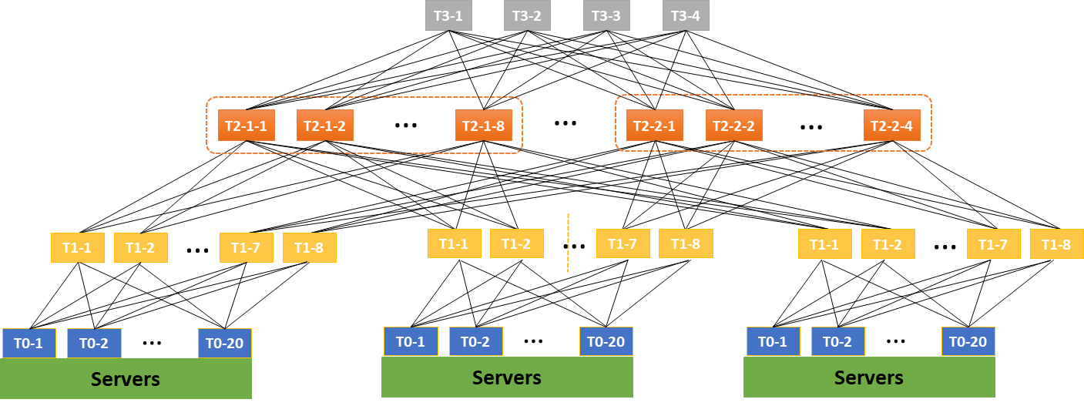


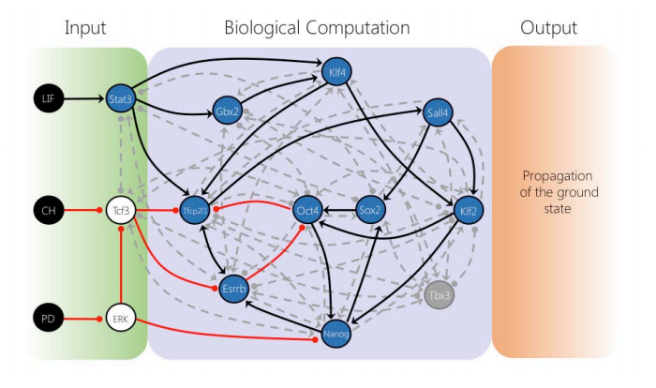



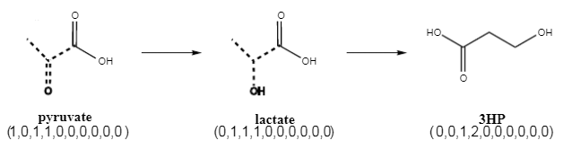



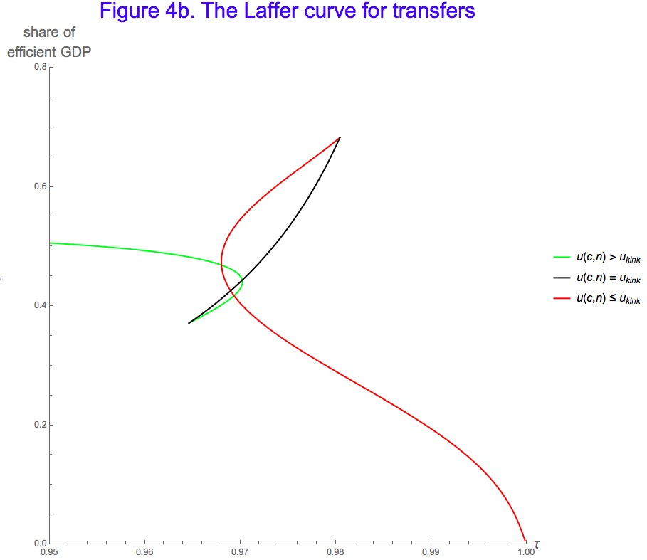


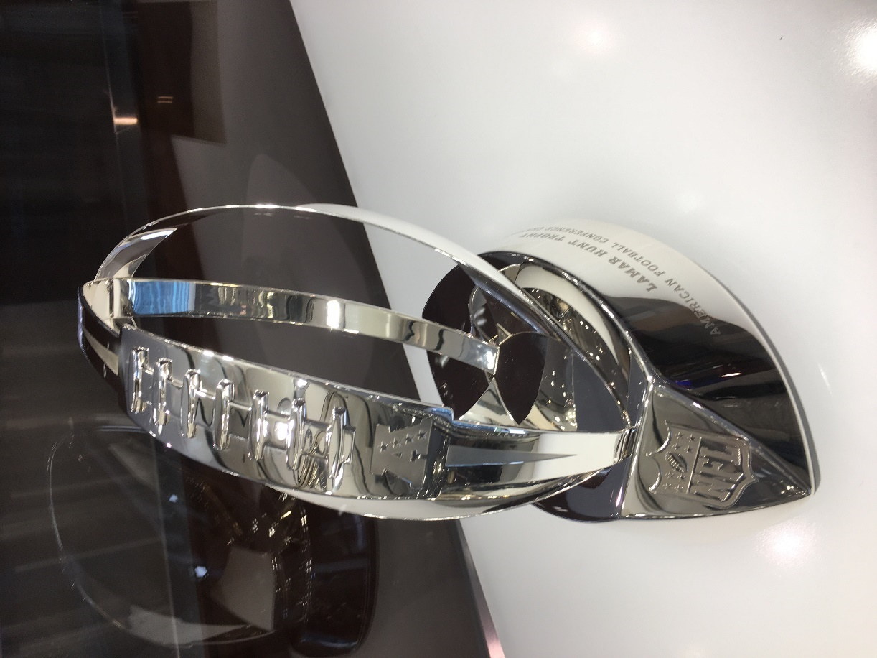
for Software +…
Azure Network
Verification
Verifying C
Compiler
Quantum
Compilation
Biological
Computations
Verified Crypto
Libraries & Protocols
Dynamics
AX
SVACE
Static Analysis Engines
Artificial
Life
Security Risk Detection
Smart Contract
Verification
ALIVE2
Translation Validation
for LLVM & Visual C++
Axiomatic
Economics
NFL
Scheduling

Slide 36
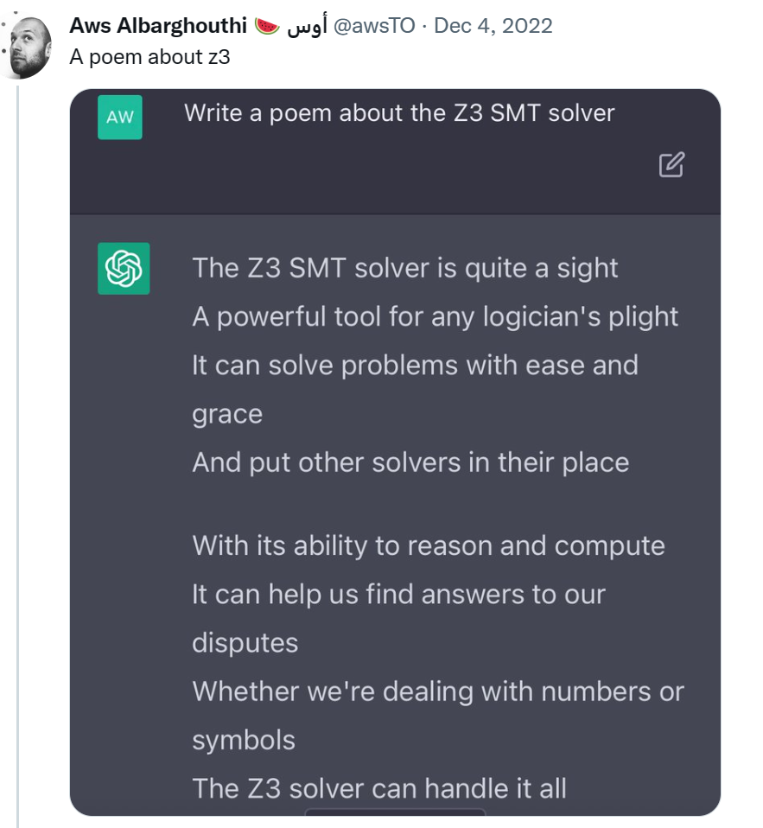
SMT and Proof Assistants
SMT
Feed formulas
No assurance of consistency
Built-in theories
Automation is job #1
Poems? Tables with runtimes
LISP, no editors
Type theory as a distraction
Int, Real
Gigantic trusted kernel
Proof validation
Z3: Algorithms, Heuristics, SE customers
Proof Assistants
Develop and maintain theories
Ensure consistency
Extensible theories
Empower users to automate
Career defining microcosmos
Editors
Powerful type theories (or ACL2)
Church Numerals, Dedekind cuts
Lean trusted kernels
Consistency by construction
LEAN: early aim articulated as “power of Coq with ease of Isabelle”

Slide 37




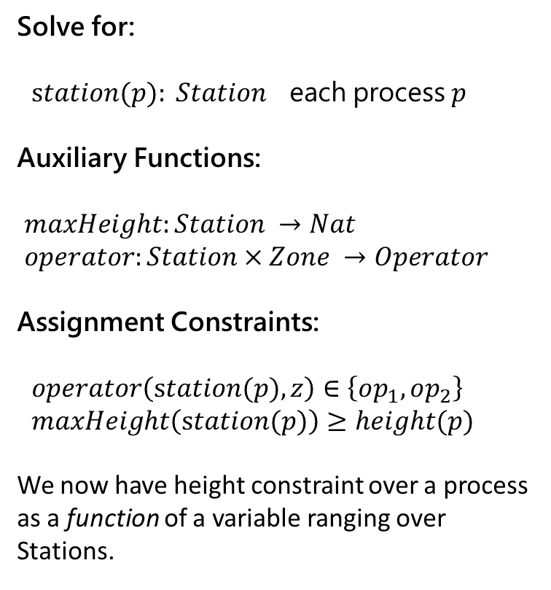
Encoding – A case study
Solve for:
$station(p): Station$ each process $p$
Auxiliary Functions:
$maxHeight:Station →Nat$
$operator:Station×Zone →Operator$
Assignment Constraints:
$operator\left(station(p),z\right)∈\left\{op_{1},op_{2}\right\}$
$maxHeight\left(station(p)\right)≥height(p)$
We now have height constraint over a process as a function of a variable ranging over Stations.
Process
Task 1
Task 2
Task 3
Task 4
Task 5
Task 6
Process
Task 1
Task 2
Task 3
Task 4
Task 5
Task 6
Process
Task 1
Task 2
Task 3
Task 4
Task 5

Slide 38
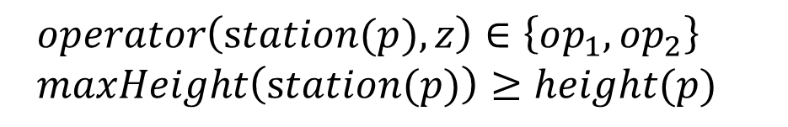
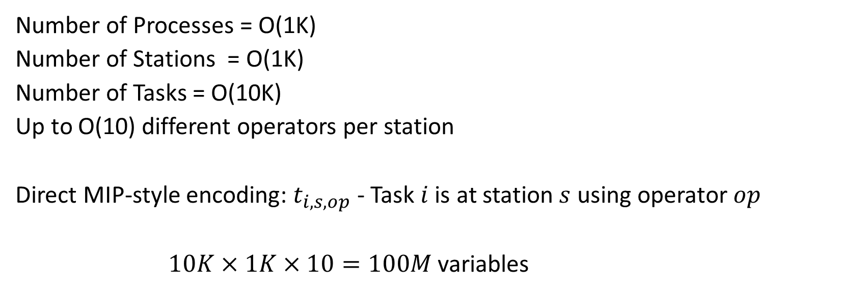
Encoding - Domain Overload
Number of Processes = O(1K)
Number of Stations = O(1K)
Number of Tasks = O(10K)
Up to O(10) different operators per station
Direct MIP-style encoding: $t_{i,s,op}$ - Task $i$ is at station $s$ using operator $op$
$10K×1K×10=100M$ variables
SMT approach: Use uninterpreted functions for “symbolic indices”
$operator\left(station(p),z\right)∈\left\{op_{1},op_{2}\right\}$
$maxHeight\left(station(p)\right)≥height(p)$

Slide 39
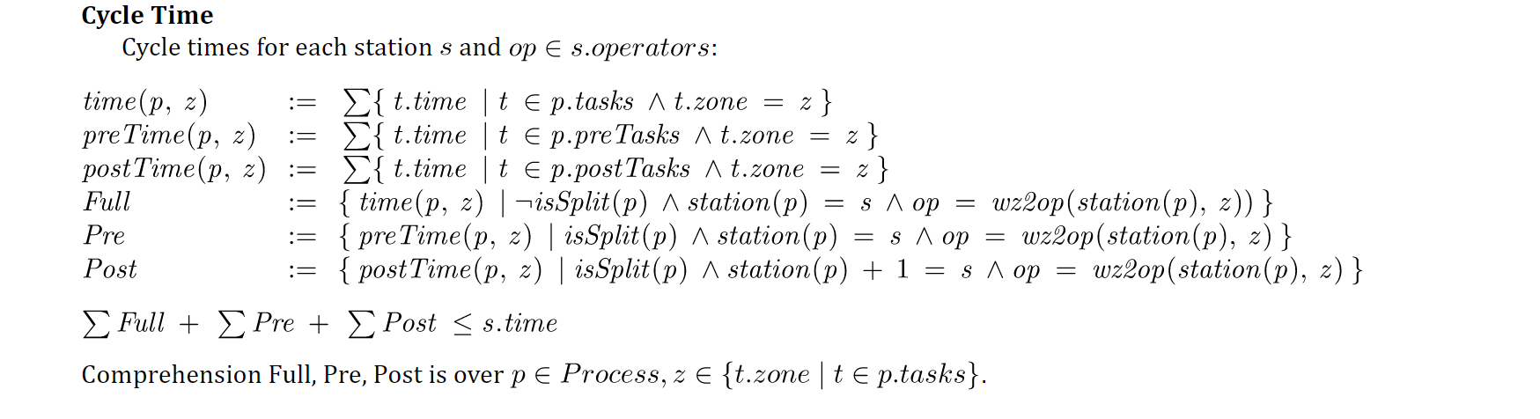
Encoding - Constraint Overload
a polluting, nasty side constraint
Constrained multi-knapsack:
A set of items, each is added to one knapsack, subject to side-constraints
Z3 approach: Programming Custom Theories (no built-in scheduling constraints)

Slide 40
Encoding – A humble path of discovery
v1: Pre-solving
Assign a small batch of 4-10 processes to stations at a time
v2: Pre-solving take two
Assign just one process at a time and only encode process constraints when a process gets assigned.
The resulting solver can assign 950 out of 1050 processes in a few minutes.
v3: A custom CDCL / CSP solver
Perform branching and propagation of cycle time constraints on top of repeated calls to Z3.
Maintain backtracking stack and add lemmas based on the chosen branches.
This was complex to engineer and only exercised in preliminary form.
v4: with Custom Propagator and Bit-vectors
With bit-vectors, without cycle-time: solvable in 30 seconds.
With bit-vectors and cycle-time: solvable for 300 processes in a few minutes, but not all processes.
With bit-vectors, programmable-propagator for cycle-time: patching + solving
Stations and processes, station heights and task time are integers
Solved 100 processes very slowly.
Initial: a few hours
Current: a few minutes.

Slide 41
Interfacing with Z3
Some anecdotal experiences
SMT is automatic, crunches on low level constraints,
but debugging and transparency remains really hard

Slide 42
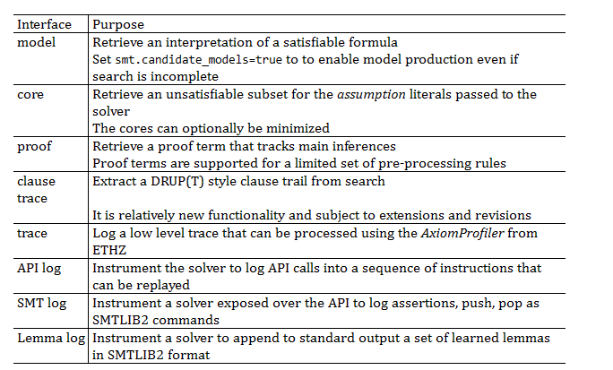
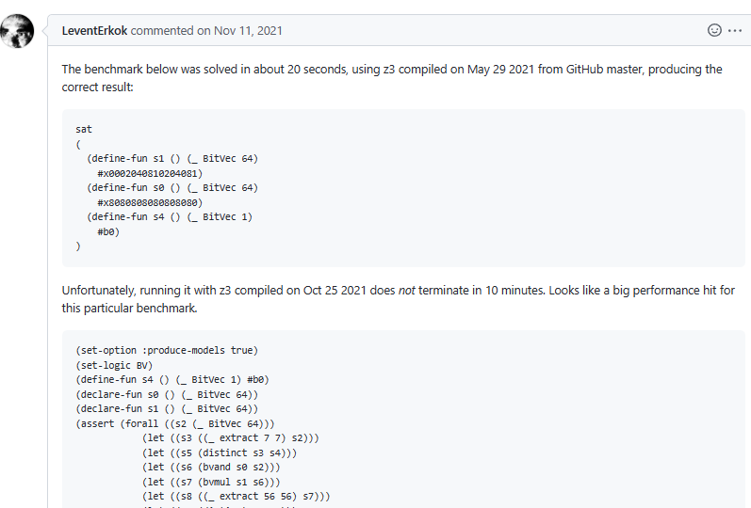
Retrieving Information
A case study in tuning z3

Slide 43
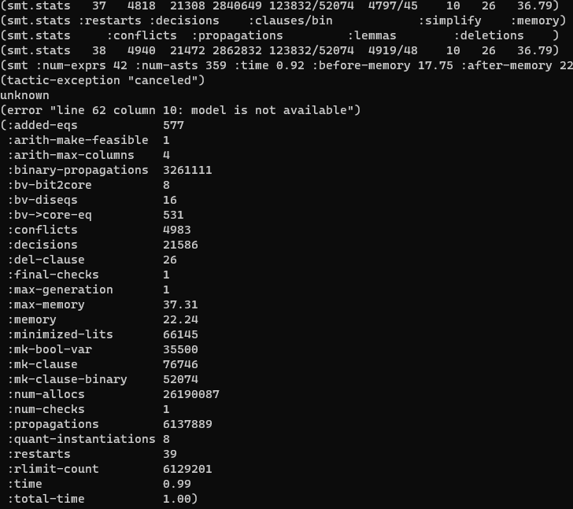
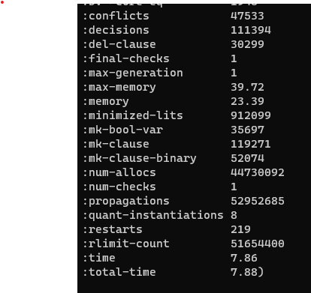
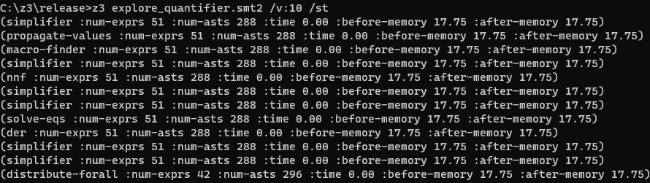
Retrieving Information – for diagnostics
Conflicts grow, but no new quantifier instantiations
First attempt
Run verbose
Get statistics
Very few quantifier instantiations

Slide 44
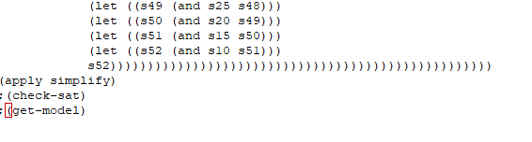
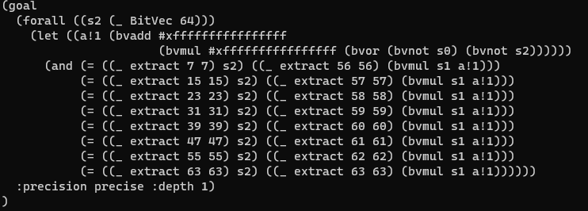
Retrieving Information
So lots of conflicts. No quantifier instantiations.
Stuck with multiplier reasoning?
What formula is being solved?
Where does this funny
-1 – 1*(~s0 | ~s2) come from?
It’s a regression. New rewrite rule that is harmful to solver!
~x = -1 – 1*x

Slide 45
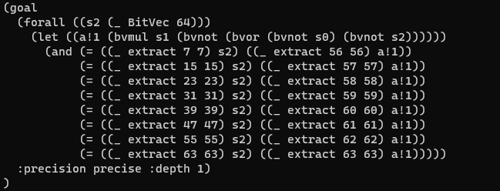
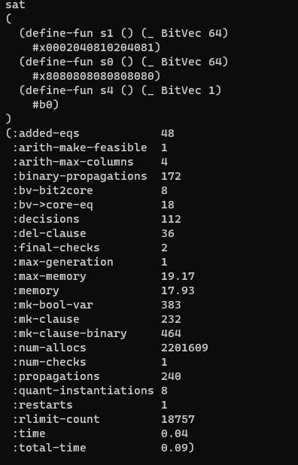
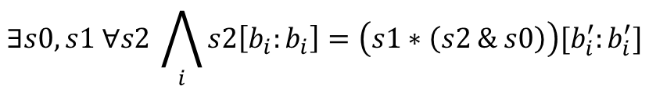
Retrieving Information
Funny rewrite, reverted
It is solved immediately
$$∃s0,s1 ∀s2 \bigwedge_{i}{s2\left[b_{i}:b_{i}\right]=\left(s1∗\left(s2 \& s0\right)\right)[b_{i}^{′}:b_{i}^{′}]}$$

Slide 46
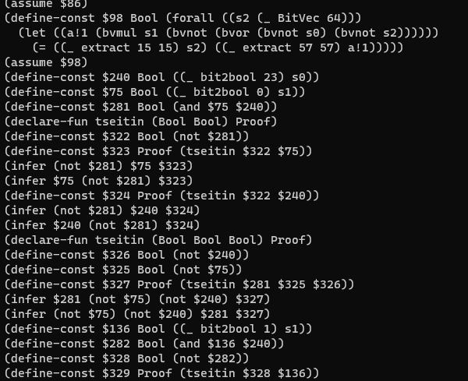
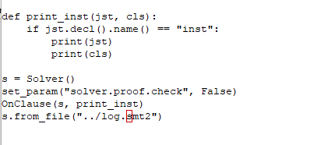
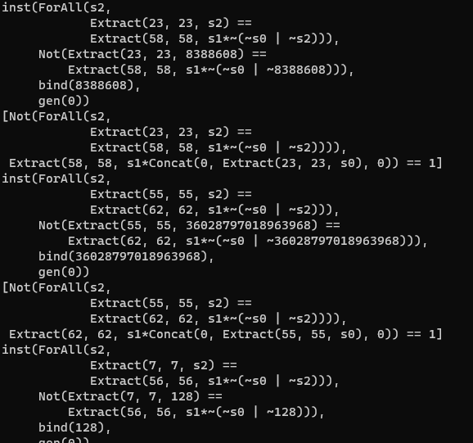
Retrieving Information – what are the inferences? (preview of clause logs)
Log is not readable by itself
But I can write a script to filter through log
It prints instances in Z3’s Python format

Slide 47
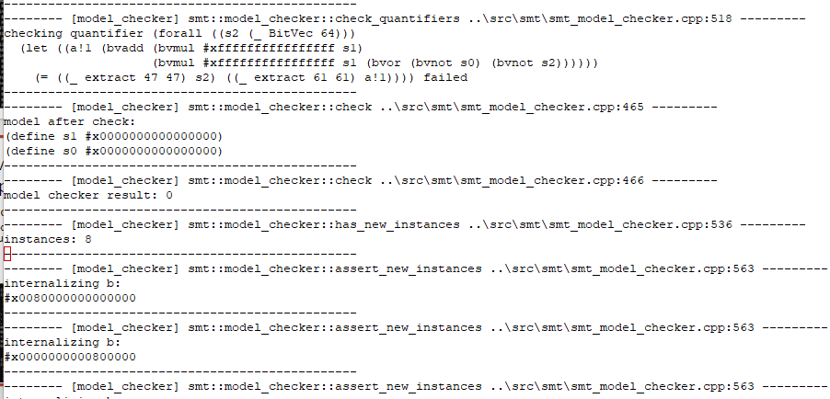
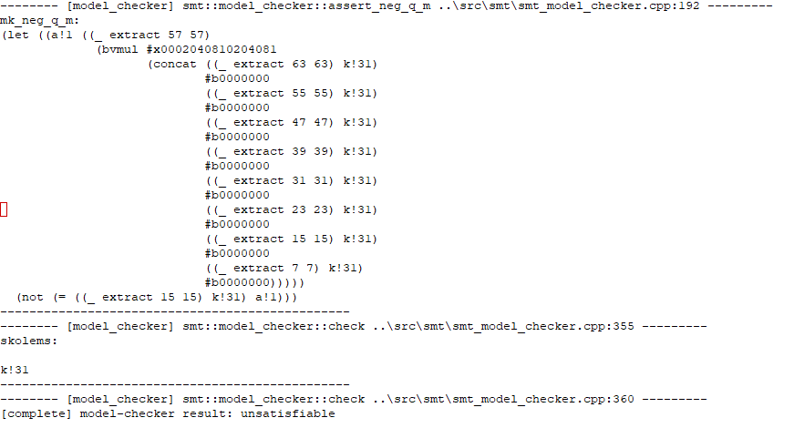
Retrieving information – “I program z3 and I have no life version”
Where does it get stuck?
-tr:model_checker – debug trace what does MBQI do?
Last MBQI check-sat call
(with fix)
Second to last call
(without fix)

Slide 48
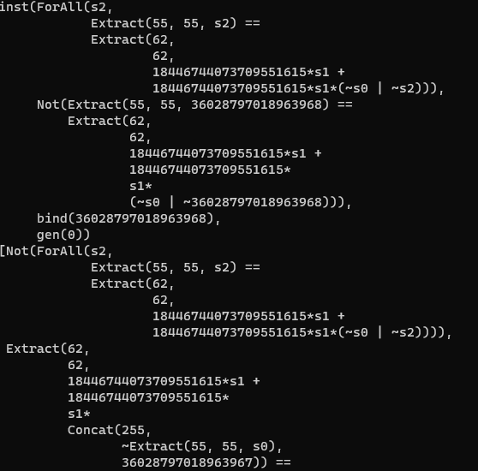
Retrieving information – “I program z3 and I have no life version”
Instances
(without fix)
Instances
(with fix)
Much cheaper for bit-blasting!

Slide 49
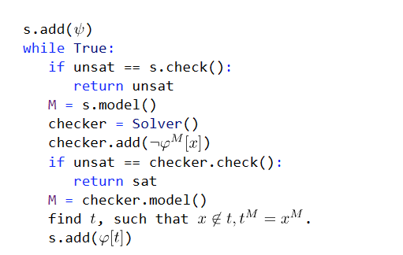
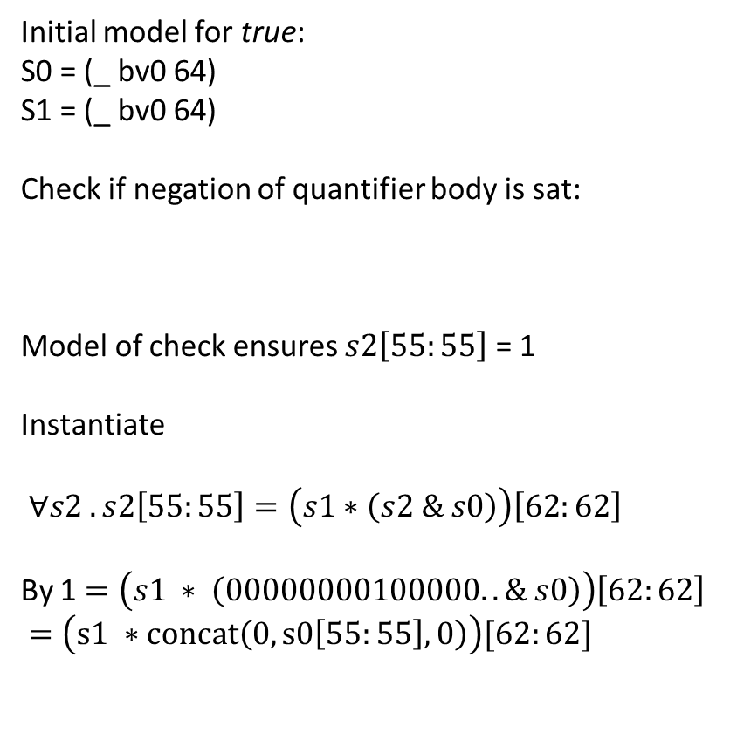
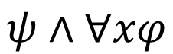
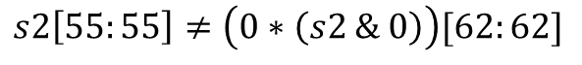
Retrieving information
Initial model for true:
S0 = (_ bv0 64)
S1 = (_ bv0 64)
Check if negation of quantifier body is sat:
Model of check ensures $s2\left[55:55\right]$ = 1
Instantiate
$∀s2 . s2\left[55:55\right]=\left(s1∗\left(s2 \& s0\right)\right)\left[62:62\right]$
By 1 $=\left(s1 ∗ \left(00000000100000.. \& s0\right)\right)\left[62:62\right]$
$=\left(s1 ∗concat\left(0, s0\left[55:55\right],0\right)\right)[62:62]$
How does MBQI work?
$$ψ∧∀xφ$$
$$s2\left[55:55\right]≠\left(0∗\left(s2 \& 0\right)\right)[62:62]$$

Slide 50
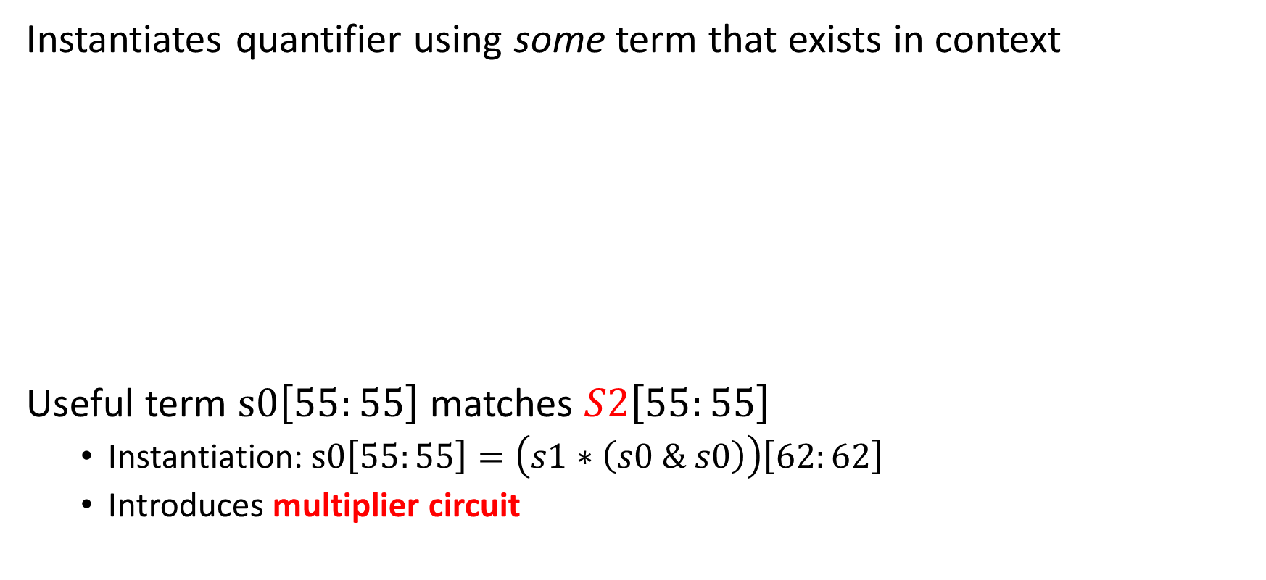
Retrieving information - Why not E-matching?
Instantiates quantifier using some term that exists in context
Useful term $s0\left[55:55\right]$ matches $S2\left[55:55\right]$
Instantiation: $s0\left[55:55\right]=\left(s1∗\left(s0 \& s0\right)\right)\left[62:62\right]$
Introduces multiplier circuit
$∀S2 . S2\left[55:55\right]=\left(s1∗\left(S2 \& s0\right)\right)\left[62:62\right]$
1 $=\left(s1 ∗concat\left(0, s0\left[55:55\right],0\right)\right)[62:62]$

Slide 51
Retrieving information
a₀∧b₃
a₀∧b₂
a₀∧b₁
a₀∧b₀
Bit-blasting, cost of multipliers
Multiplier circuits for 64 bits are super expensive
HA
a₁∧b₂
HA
a₁∧b₁
HA
a₁∧b₀
FA
a₂∧b₁
FA
a₂∧b₀
FA
a₃∧b₀
out₃
out₂
out₁
out₀

Slide 52
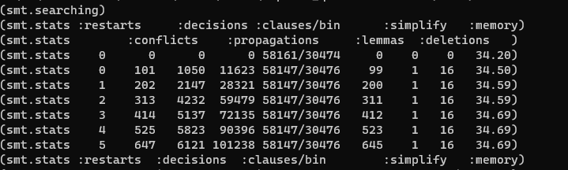
Retrieving information
Trying QSAT
QSAT solves satisfiability for nested quantifiers.
It works on top of bit-vectors
=> bit-vector multiplier circuit recompiled on every instantiation
(apply (then simplify qsat) :print_statistics true)

Slide 53

Skip repeated bit-blasting
(apply (then simplify
(with bit-blast :blast_quant true)
qsat) :print_statistics true)
The problem is now pure 2-QBF.
Option:
Feed output of tactic (w/o qsat)
to a dedicated QBF solver.
TODO

Slide 54


The magic didn’t happen
(apply (then simplify
(with bit-blast :blast_quant true)
qsat) :print_statistics true)
But MBQI also works with bit-blasted:
(check-sat-using (then
simplify
(with bit-blast :blast_quant true)
smt) :print_statistics true)

Slide 55
Revising hypotheses
Was this rewrite the real culprit?
~x = -1 – 1*x

Slide 56


A domain Insight
What are we solving, in a nutshell:
Bit-wise & retains bits from s2 where s0 has bits set to 1
Bit-wise * retains bits form $\left(s2 \& s0\right)$ where s1 has bits set to 1
System is less constrained the fewer bits in s0, s1 are set to 1.
=> Find models for s0, s1 with fewest bits set to 1
$$∃s0,s1 ∀s2 \bigwedge_{i}{s2\left[b_{i}:b_{i}\right]=\left(s1∗\left(s2 \& s0\right)\right)[b_{i}^{′}:b_{i}^{′}]}$$

Slide 57

Retrieving information
Uses incremental pre-processing
tinkering with sat.smt=true
TODO

Slide 58


Retrieving information – digging into tactics
$∀s2 . s2\left[55:55\right]=\left(s1∗\left(\sim \left(\sim s2 \right|\sim s0\right))\right)\left[62:62\right]$
~s0 occurs in single position
Replace by fresh variable
Replaced by fresh variable

Slide 59


Retrieving information
After ~s0 was replaced by fresh variable k!0
Bits in k!0 are opposite polarity of s0
Branch ordering based on setting bits in inputs to 0 is broken!

Slide 60

A custom MBQI with optimization
https://Microsoft.github.io/z3guide/programming/Example%20Programs/MBQI
Solves problem very quickly, no dependency on variable phases

Slide 61
Retrieving information - recap
Verbose mode
Statistics
Inspect result from pre-solve (apply simplify)
Instrument Clause Traces
Shape hypotheses, revisit them
Debug traces
Clause traces again

Slide 62
Encoding – generic rules
Introducing helpful predicates
Can a model capture the likes of Ackermann reductions, cuts?
Watch out for N x M overhead. Can you use functions?
CDCL(T) is just horrible at problems with symmetries.
More theories isn’t better. Common trap is mixing bit-vectors with ints.
Use succinct encodings when available, if not use quantifiers or Custom Theories
Break symmetries in encodings
Heed the cost of impure and mixed theories

Slide 63
Encoding – The power of SAT solvers (?)
Z3 is more stable for unsatisfiable problems than satisfiable problems.
Partial control by using knobs such as smt.phase_caching_on=80000, sat.threads=4
CDCL is horrible at xor reasoning. By nature, CDCL SAT searches for regular resolution proofs.
There are no existing knobs to make xor work, but a CryptoMiniSAT T-solver in the works.
SAT is a solved problem, right?

Slide 64
Encoding – CDCL(EUF)
Shifting reasoning about uninterpreted functions to the CDCL SAT core can produce significant speedups
The CDCL core has no E-node overhead, learns strong lemmas
The CDCL core does not scale with encodings that grow by cross-products
Shifting reasoning about uninterpreted functions to the CDCL SAT core is not practical for large formulas

Slide 65
Controlling Search
Z3 does not use cores unless you ask it to
You can parallelize z3 in several ways
parallel.enable=true (cube and conquer)
Solver is super sensitive to tradeoffs in time spent solving vs. cubes created.
sat.threads=4
Run parallel instances of sat core sharing clauses.
smt.threads=4
Run parallel instances of smt core run in multiple rounds using alternate see cubes
tactic.default_tactic=(then simplify (par-or (with smt :smt.random_seed 1) smt))
Parallel tactics, no sharing, no cubing.
Parallel Z3 doesn't offer any speedups
But don’t expect miracles..
you have to tune yourself

Slide 66
Finite Sets
Defining a Signature

Slide 67

Finite Sets - Signature
$∅, \left\{ x \right\}, S∪T, S∩T, S∖T$- set constructors
$x∈S$ – set membership
$S=T, S⊆T$- equ
$\left|S\right| :Nat$ - size of set
$\left[l .. u\right]\text{: }\text{Set} \text{Int}\text{ - }\text{set} \text{comprising} \text{of} \text{an} \text{interval}$
$\left\{ x∈Set α ∣ φ\left(x\right)\right\}\text{- }\text{s}\text{et} \text{comprehension}$
$f\left(S\right)$- image of set under function $f :α→β →\left(Set α\right) →\left(Set β\right)$

Slide 68

Task 1 – parsing and printing
allow Z3 to Finite Set signatures over SMTLIB

Slide 69


Task 1 – parsing and printing
Z3 $↔$ SMTLIB

Slide 70

This is really a boiler-plate task, let’s bootstrap

